Slide 1
Smolenice, SK 18-21/9/2017
International scientific conference
SNOW - an ecological phenomenon
ES1404 MC+WGs meeting

Slide 2
Conference on
SNOW - an ecological phenomenon
Sessions
-snow measurements/detection
-snow and vegetation cycle
-spatial and temporal distribution of snow
-snow in different sectors (touristic, transport etc.)
-poster session
(modification of sessions possible)

Slide 3
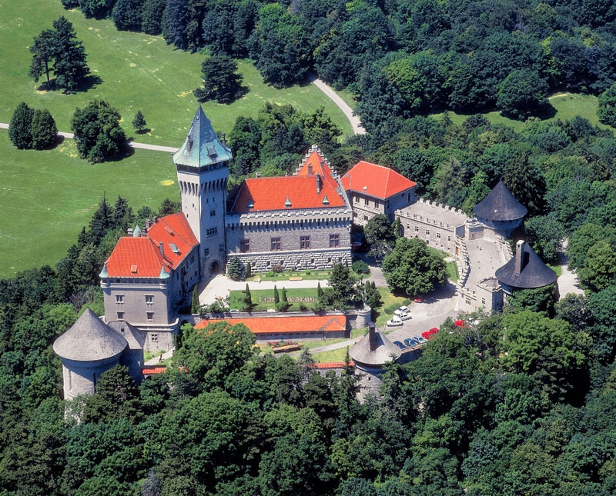
Congress Centre of SAS, Smolenice castle

Slide 4
Congress facilities
Accommodation facilities
Room | Capacity
Conference room | 100
Forester style saloon | 38
Small conference room | 20
Red saloon | 20
Courtyard room | 50
Bastion-vinery | 30
Library | 20
Room | Nb. | Price €
Single | 9 | 40
Double | 16 | 70
Tripple | 8 | 90
Quadro | 3 | 100
Apartman | 6 | 120
Further accommodation possible in a hotel and penzions in Smolenice.
10-15 min walking distance.

Slide 5
Boarding
Travel
Smolenice is accessible by bus and train
Flying to Vienna
Taking bus to Bratislava
(each 30 min)
Taking bus to Smolenice
(a bus from Bratislava to Smolenice can be arranged)
Castle restaurant opened during the events
Full board 24 €
Further boarding possibilities in Smolenice

Slide 6
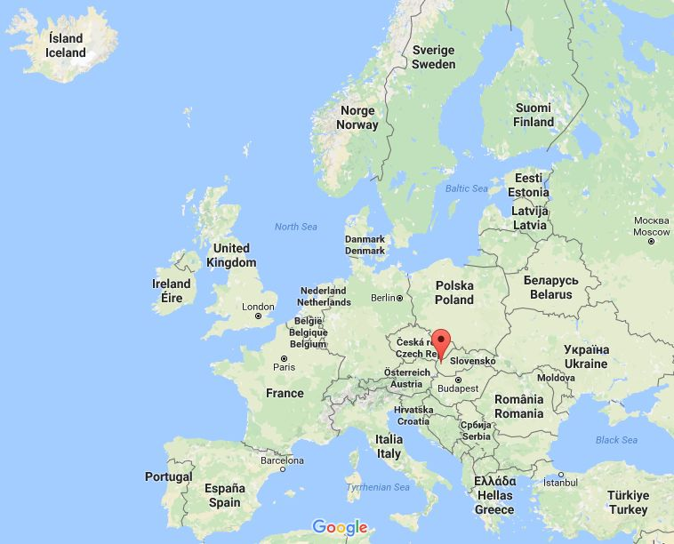
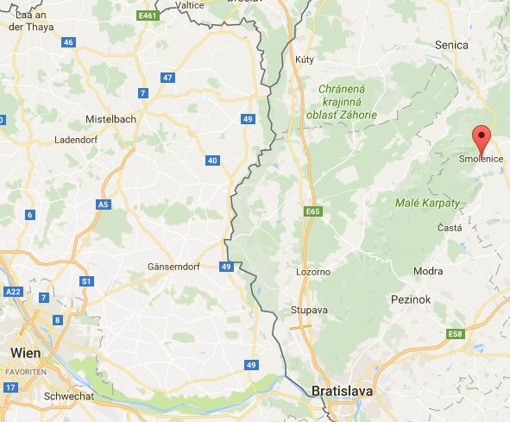

Slide 7
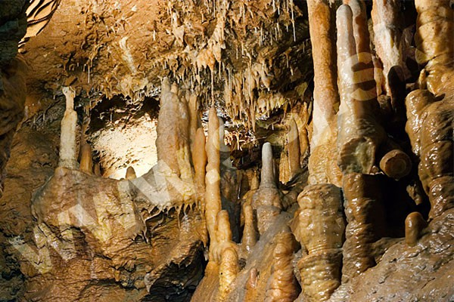
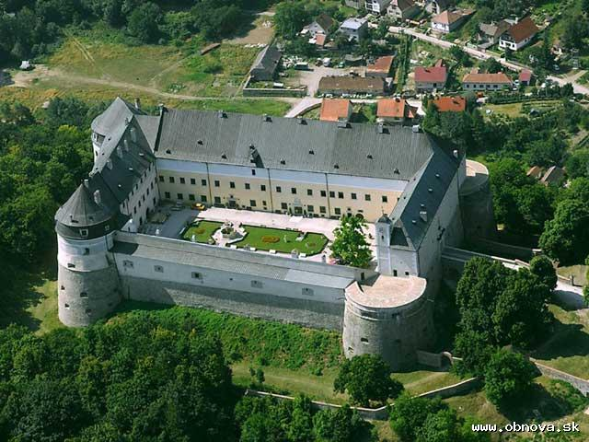
Sights around
Driny cave
Walking distance from the castle
Cerveny kamen castle
20 min by bus, biggest cellars in Central Europe

